Slide 1

AUTOMATION OF CODE BUILDING & DEPLOYMENT
Building a GitHub-Teamcity-Docker pipeline
Prachitee Maratkar
Medha Shaharkar
IB-IT GED-Risk Interns

Slide 2
Problem Statement :
Lack of Demand Management and Onboarding Tracking Tool
Proposed Solution :
High Level Requirement
Tracking
On Boarding
Project Allocation
Report
Checklist
Tracking
Demand Management
Technology
Angular
Nodejs
Oracle
Benefits
Reduction Of Manual Work
Accessibility
Scalable
Tracking at one place
Security
Flexible/ Dynamic

Slide 3
Demand Management Tool
Agile Methodology
Requirement
Plan
Design
Feedback
Develop
Grid
Project Allocation
Tracking
Grid
Tracking
Searchable
Sortable
Editable
Add Project
Download Report
Download Report
Add Request
Login
Editable
Sortable
Searchable
Total Allocation % current month
User Type
Admin
Line Manager
Super User
Admin
Add
Update
User Type
Update Password
Users
Form
Auto-Complete
Validation
All Request
Credentials
Verification
New Password
Logout
User GPN
Access Token
Functionality:

Slide 4
On Boarding Tool
Functionality:
Line Manager
Admin
Search
On Boarding
Login
User Type
Admin
Line Manager
Super User
Admin
Add
Update
Checklist
Update Password
Users
Checklist
Update
Tracking
Credentials
Verification
Resource
All Users
Update
Track
Logout
User GPN
Access Token
New Password

Slide 5
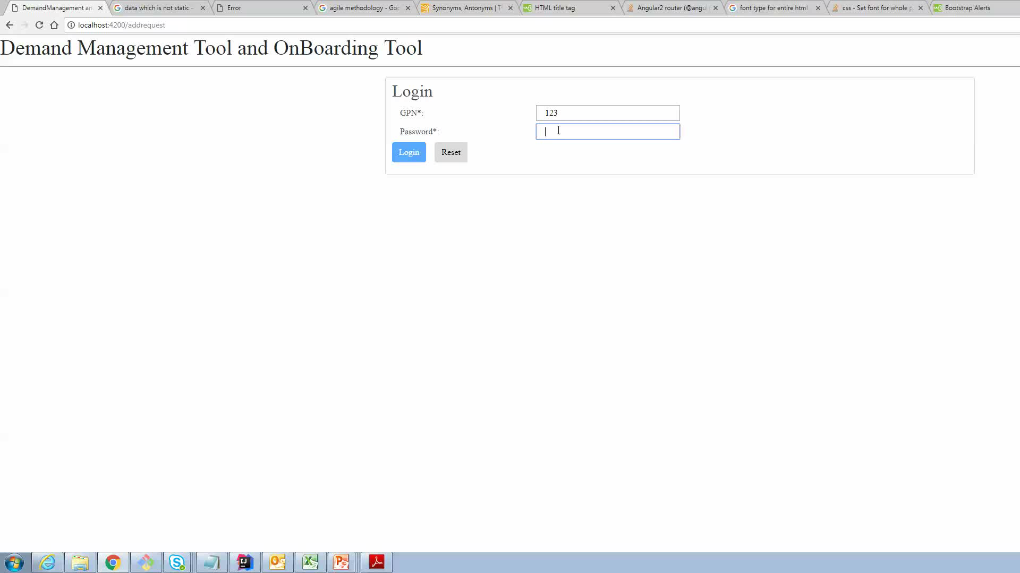
Demo

Slide 6
Future Scope and Learnings
Web-SSO
Brassring
Workforce Planning tool
Future Scope
Angular, Nodejs ,Oracle
Agile Methodology
Testing
Corporate Culture
Learnings

